Slide 1
Day 15
Machine Learning
By
Pankaj Shukla
Joint Director, NIELIT Lucknow
Notes:
1

Slide 2
Confusion Matrix

Slide 3
Classification Accuracy
Classification accuracy alone can be misleading if you have an unequal number of observations in each class or if you have more than two classes in your dataset.
Calculating a confusion matrix can give you a better idea of what your classification model is getting right and what types of errors it is making.

Slide 4
Classification Accuracy
Classification Accuracy and its Limitations
Classification accuracy is the ratio of correct predictions to total predictions made.
classification accuracy = correct predictions / total predictions
It is often presented as a percentage by multiplying the result by 100.
classification accuracy = correct predictions / total predictions *100

Slide 5
Classification Error Rate
Error Rate
Classification accuracy can also easily be turned into a misclassification rate or error rate by inverting the value, such as:
error rate = (1 - (correct predictions / total predictions)) * 100

Slide 6
Problems with Accuracy
The main problem with classification accuracy is that it hides the detail you need to better understand the performance of your classification model. There are two examples where you are most likely to encounter this problem:
When you are data has more than 2 classes. With 3 or more classes you may get a classification accuracy of 80%, but you don’t know if that is because all classes are being predicted equally well or whether one or two classes are being neglected by the model.
When your data does not have an even number of classes. You may achieve accuracy of 90% or more, but this is not a good score if 90 records for every 100 belong to one class and you can achieve this score by always predicting the most common class value.

Slide 7
Confusion Matrix in Machine Learning
A confusion matrix is a summary of prediction results on a classification problem.
In the field of machine learning and specifically the problem of statistical classification, a confusion matrix, also known as an error matrix.
A confusion matrix is a table that is often used to describe the performance of a classification model (or “classifier”) on a set of test data for which the true values are known.

Slide 8
It allows the visualization of the performance of an algorithm.
It allows easy identification of confusion between classes e.g. one class is commonly mislabeled as the other. Most performance measures are computed from the confusion matrix.
The confusion matrix shows the ways in which your classification model is confused when it makes predictions.

Slide 9
Confusion Matrix:
A confusion matrix is a summary of prediction results on a classification problem.
The number of correct and incorrect predictions are summarized with count values and broken down by each class.
This is the key to the confusion matrix.
The confusion matrix shows the ways in which your classification model is confused when it makes predictions.
It gives us insight not only into the errors being made by a classifier but more importantly the types of errors that are being made.

Slide 10
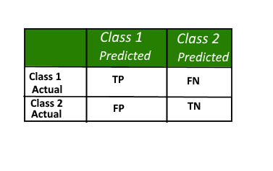
Here,
• Class 1 : Positive
• Class 2 : Negative

Slide 11
Definition of the Terms:
Positive (P) : Observation is positive (for example: is an apple).
Negative (N) : Observation is not positive (for example: is not an apple).
True Positive (TP) : Observation is positive, and is predicted to be positive.
False Negative (FN) : Observation is positive, but is predicted negative.
True Negative (TN) : Observation is negative, and is predicted to be negative.
False Positive (FP) : Observation is negative, but is predicted positive.

Slide 12
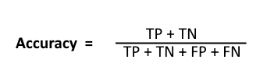
Classification Rate/Accuracy:
Classification Rate or Accuracy is given by the relation:
However, there are problems with accuracy. It assumes equal costs for both kinds of errors. A 99% accuracy can be excellent, good, mediocre, poor or terrible depending upon the problem.

Slide 13
Misclassification Rate/Error:
Misclassification Rate:
how often is it wrong?
MR = (FP+FN)/total
MR = (10+5)/165 = 0.09
This is also called as the Error Rate

Slide 14

Recall:
Recall can be defined as the ratio of the total number of correctly classified positive examples divide to the total number of positive examples. High Recall indicates the class is correctly recognized (small number of FN).
Also known as sensitivity, hit rate, or true positive rate (TPR)
Recall is given by the relation:

Slide 15

Precision/Positive Predictive Value:
To get the value of precision we divide the total number of correctly classified positive examples by the total number of predicted positive examples. High Precision indicates an example labeled as positive is indeed positive (small number of FP). Precision is given by the relation:

Slide 16
specificity, selectivity or true negative rate (TNR)
Specificity relates to the test's ability to correctly reject healthy patients without a condition. Consider the example of a medical test for diagnosing a disease. Specificity of a test is the proportion of healthy patients known not to have the disease, who will test negative for it. Mathematically, this can also be written as:
Specificity = TN/(TN+FP)

Slide 17
High recall, low precision:
This means that most of the positive examples are correctly recognized (low FN) but there are a lot of false positives.

Slide 18
Low recall, high precision:
This shows that we miss a lot of positive examples (high FN) but those we predict as positive are indeed positive (low FP)

Slide 19

F-measure:
Since we have two measures (Precision and Recall) it helps to have a measurement that represents both of them. We calculate an F-measure which uses Harmonic Mean in place of Arithmetic Mean as it punishes the extreme values more.
The F-Measure will always be nearer to the smaller value of Precision or Recall.

Slide 20
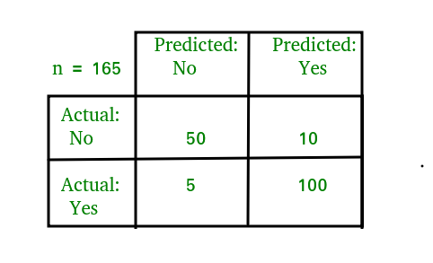
When taking the arithmetic mean, it would have 50% correct. Despite being the worst possible outcome! While taking the harmonic mean, the F-measure is 0.
Example to interprete confusion matrix:

Slide 21
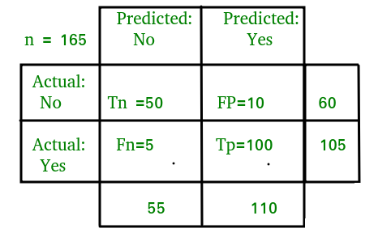
For the simplification of the above confusion matrix i have added all the terms like TP,FP,etc and the row and column totals in the following image:

Slide 22
Now,
Classification Rate/Accuracy:
Accuracy = (TP + TN) / (TP + TN + FP + FN)= (100+50) /(100+5+10+50)= 0.90
Recall:Recall gives us an idea about when it’s actually yes, how often does it predict yes.
Recall=TP / (TP + FN)=100/(100+5)=0.95

Slide 23
Precision: Precision tells us about when it predicts yes, how often is it correct.
Precision = TP / (TP + FP)=100/ (100+10)=0.91
F-measure:
Fmeasure=(2*Recall*Precision)/(Recall+Presision)=(2*0.95*0.91)/(0.91+0.95)=0.92

Slide 24
Confusion Matrix
Python Implementation

Slide 25
Python script for confusion matrix creation.
from sklearn.metrics import confusion_matrix
from sklearn.metrics import accuracy_score
from sklearn.metrics import classification_report
actual = [1, 1, 0, 1, 0, 0, 1, 0, 0, 0]
predicted = [1, 0, 0, 1, 0, 0, 1, 1, 1, 0]
results = confusion_matrix(actual, predicted)
print 'Confusion Matrix :'
print(results)
print 'Accuracy Score :',accuracy_score(actual, predicted)
print 'Report : '
print classification_report(actual, predicted)

